Slide 1

Digital Signal Processing
Lecturer ：杨鍊
科B250, Tel: 18981710751
Email：yanglian@uestc.edu.cn

Slide 2
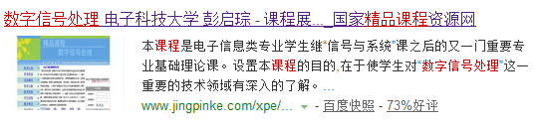
Foreword
Course Website：
http://222.197.183.243/wlxt/course.aspx?courseid=0003

Slide 3
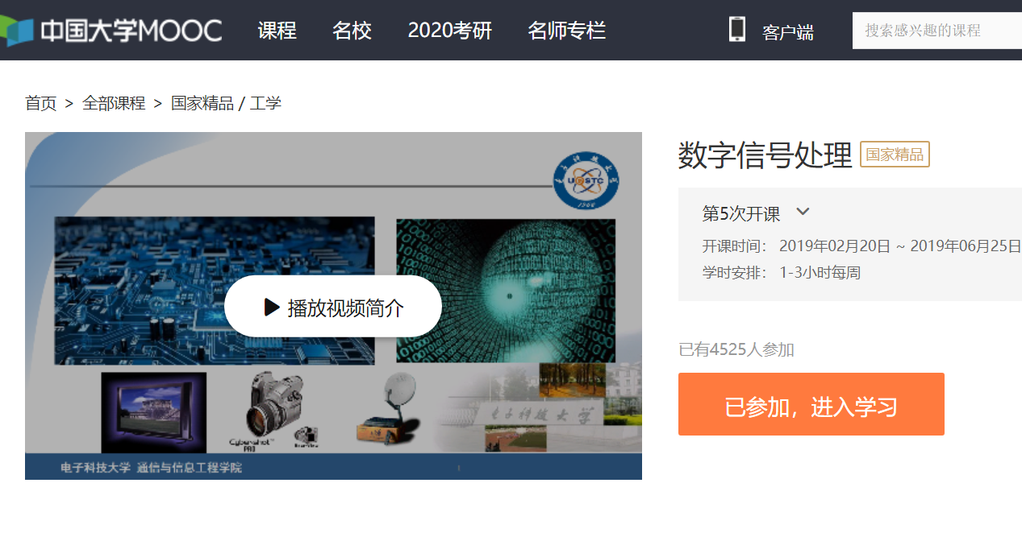
MOOC Website：
http://www.icourse163.org/course/UESTC-236010

Slide 4
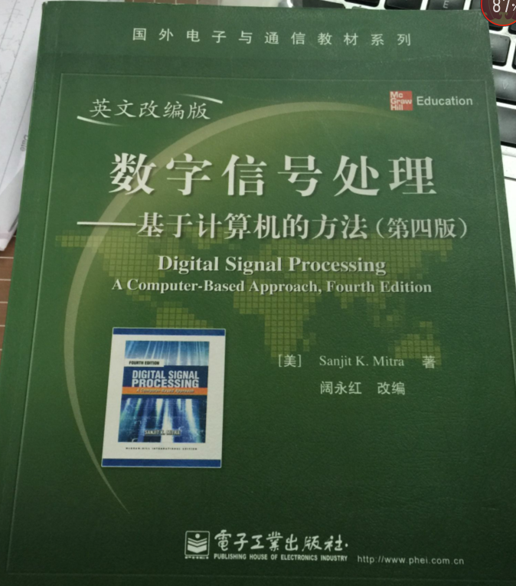
The Textbook
Digital Signal Processing----A Computer- Based Approach, Sanjit K.Mitra,4th Edition,McGraw-Hill,2014
电子工业出版社

Slide 5
Reference books
1. 奥本海姆（李玉柏等译），离散时间信号处理（原书第3版.精编版），机械工业出版社
2. 彭启琮等，数字信号处理,高等教育出版社
3. 彭启琮等,DSP与实时数字信号处理,电子科大出版社
4. 程佩青,数字信号处理教程,清华大学出版社
5.胡广书，数字信号处理——理论、算法与实现，清华大学出版社

Slide 6
Foreword
Characterization Of The Course
1.The Tech. Fields Used DSP:
Communication, Radio, Radar, Navigation, IT, etc
2. The Correlated Course:
Signals And Systems
Tech. Of DSP
Logic Circuit
DSP
Software Radio
Programm
VLSI,ASIC,……

Slide 7
Examine Methods
1. Lectures（56 courses）, Attendance and homework
2. Mid-term exam (120 mins) (Chapter[1-6])
3. Experiments
4. Final exam (120 mins) (Chapter[1-11])

Slide 8
Grading
Coursework 30%
Mid-term Exam（ 20%）
Experiments（10%）
Final Exam(40%)
Some suggestions: understand by mathematic and logic+imaginative,
do exercises and activities

Slide 9
Contents of Mooc
Mooc videos | Book chapters
Week0: DSP-introduction and MATLAB 2videos | Ch1
Week1: Digital Processing of Continuous Signals-2 | Ch2
Digital Processing of Continuous Signals-1&3 | Ch3.8
Digital Processing of Continuous Signals-4 | Ch12
Week2-3: DTFT 5videos | Ch3.1-3.6
Week4-5: Discrete Time System 4videos | Ch4
Week6: DFT 4videos | Ch5
Week7：FFT 2video | Ch11
Week8: ZT and IZT 5videos | Ch6
Week9: LTI Discrete-Time System in the Transform Domain 5videos | Ch7
Week10: Digital Filter Structures 2videos | Ch8
Week11-12: FDA tools&filter design 7videos | Ch9-10

Slide 10
Required Contents
§1
§2 2.1~2.5
§3* 3.1~3.9
§4 4.1~ 4.10
§5* 5.1~ 5.10
§6 6.1~6.7
§7 7.1~7.4
§8 8.1~8.6
§9 * 9.1~9.6
§10 * 10.1,10.2,10.5
§11 11.1~11.5
§A A.1~A.8

Slide 11
Experiments
1. Production and Detection of Dual-Tone Multi-Frequency (DTMF) Signals
2.Digital Frequency Spectrum Analysis Based on DFT

